Slide 1
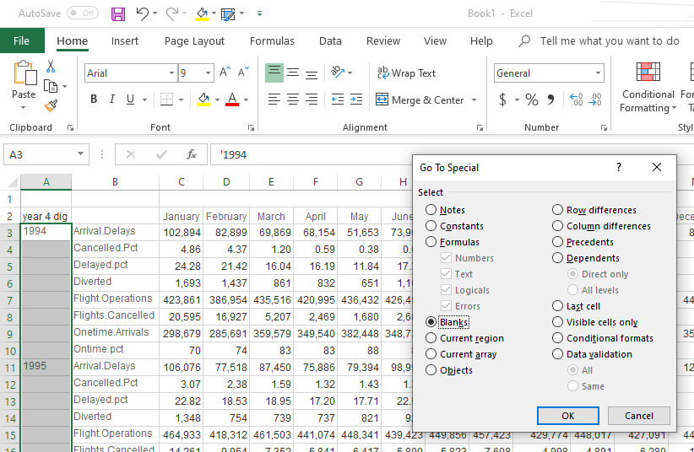
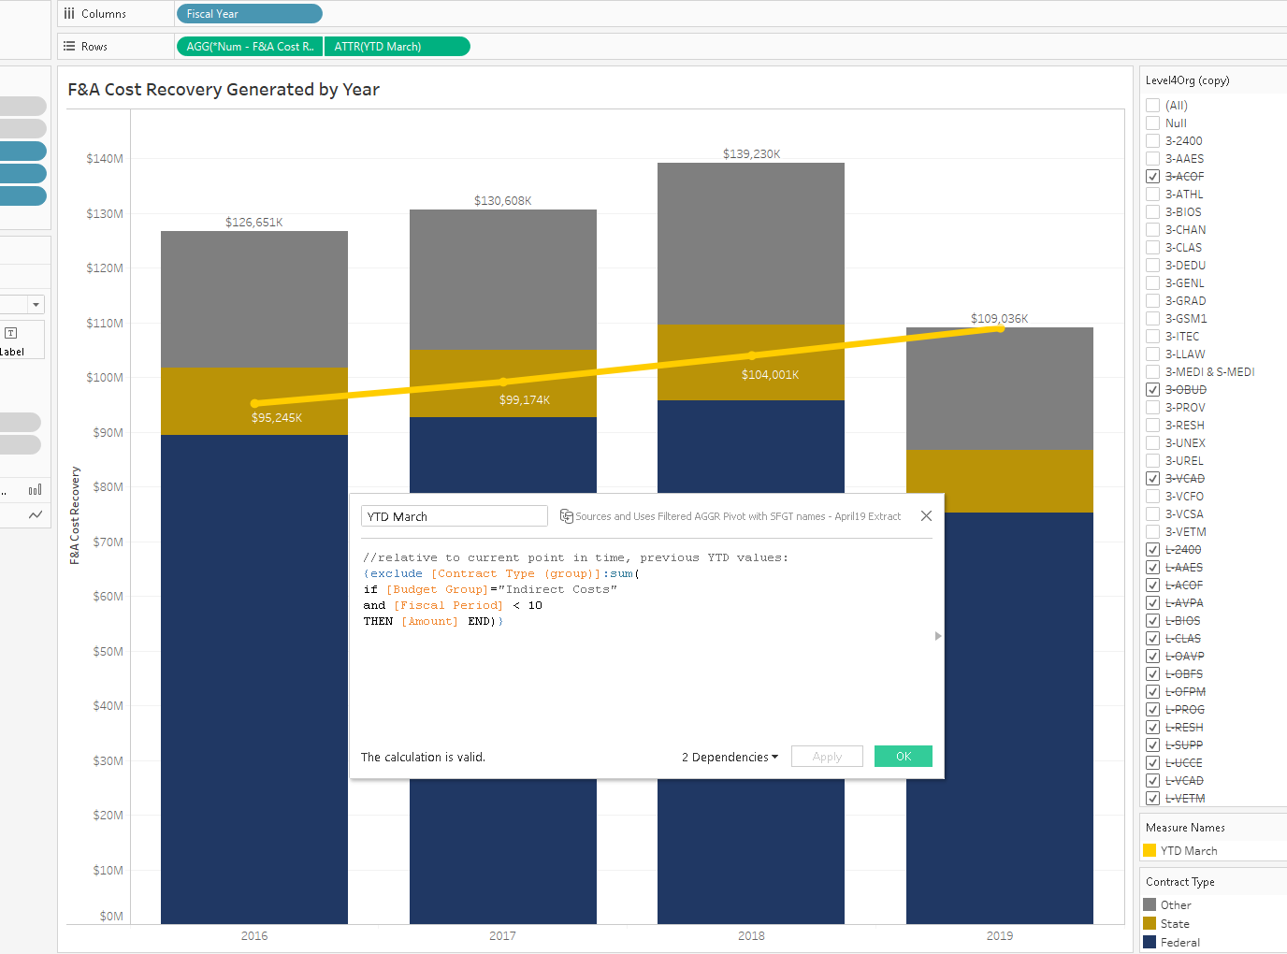
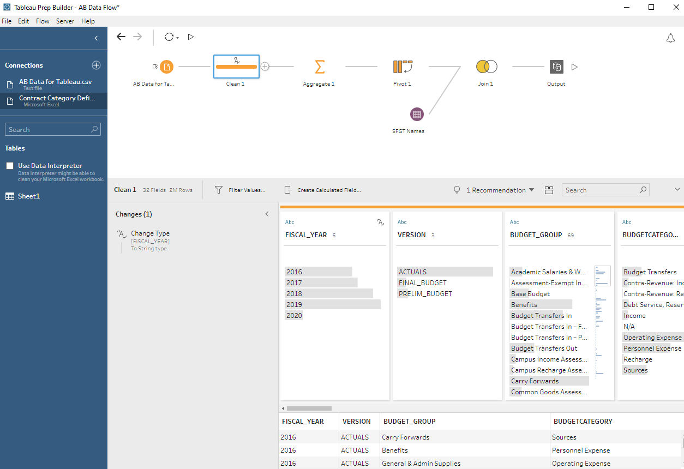
Welcome to Data and Donuts
Transitioning to Tableau - Budget and Financial Aid
Source Data
Visualization
Preparation

Slide 2
Data and Donuts
A forum for data enthusiasts to meet up, share analytical techniques and institutional knowledge, discover collaboration opportunities and present data achievements and campus data projects.
Also, donuts.
3119 International Center
October 28, 2019

Slide 3
Welcome to Data and Donuts
Thank you for joining us!
Thank you also to Karen Beardsley and Global Affairs for hosting us in this lovely setting.
We hope you get the chance to meet some folks from data subject areas that are unfamiliar to you and learn about the questions they are trying to answer with data!
Perhaps you’ll even discover a new collaboration opportunity!

Slide 4
Today’s Presentations
Nick Barbulesco – Business Intelligence
Quick updates from the Business Intelligence Office
Max Monastyrskyy
Mutually Exclusive Filter Handling in Tableau
Brendan Livingston
Using parameters to explore your data in Tableau
Sarah Mangum, Adrina Gabriel, Tiffany Wright
Budget and Institutional Analysis’ Budget Context - the journey from paper planning documentation and reports to Tableau dashboards in AggieData
Joyce Cleaver
Financial Aid’s journey to Tableau Dashboards for official reporting

Slide 5
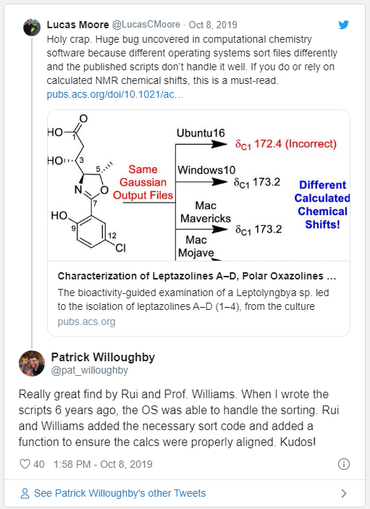
Cool Data Stuff…
Make no assumptions about nuanced integrity when using open source statistical packages…

Slide 6
Quick Updates
Business Intelligence Program Update – October 2019

Slide 7

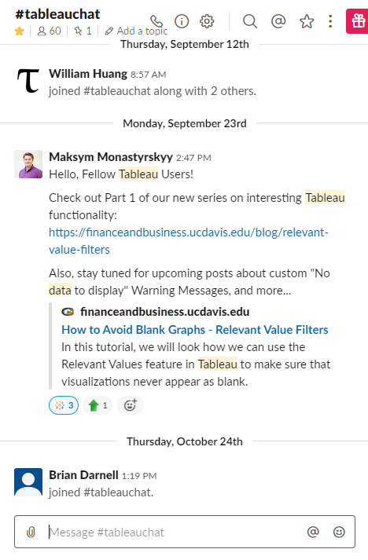
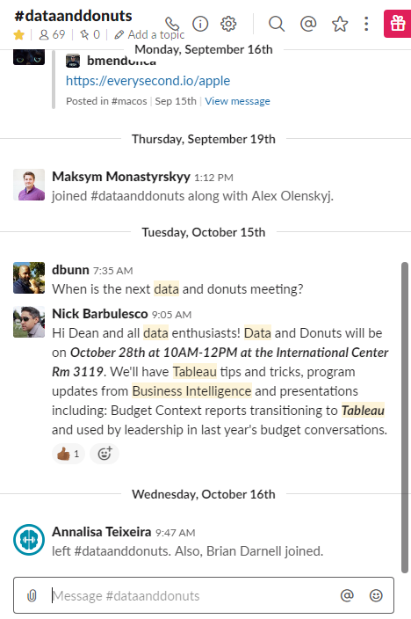
Slack Channels – let us hear from you!
#TableauChat
#DataAndDonuts

Slide 8
On-Campus Tableau Training
How many folks here today attended our beginner/intermediate Tableau training in July?
Benefits to offering this training program on campus:
We have saved the campus approximately $60k
Special thank you to:
Staff Development and Professional Services for the use of computer lab classrooms – Kelly Crabtree and her team
AdminIT resources to deploy demo version of Tableau to the classroom computers – Nathan Benedicto and his team

Slide 9
“Tableau Day” - in the works!
Coordinating with the Med Center Tableau Users to:
Gather on campus and bring Tableau users of UC Davis together
Hold an event for Tableau users to:
  Learn new tips and tricks
  Gather and network
  Showcase their work
  Ask Tableau experts your tough Tableau questions

Slide 10
Tableau Prep Training
Who’s interested?

Slide 11
BYOD (Bring Your Own… Dashboards? Data? Donuts?)
Tableau Office Hours Pilot
December 12th
9:30 to 11:30
Mrak 203

Slide 12
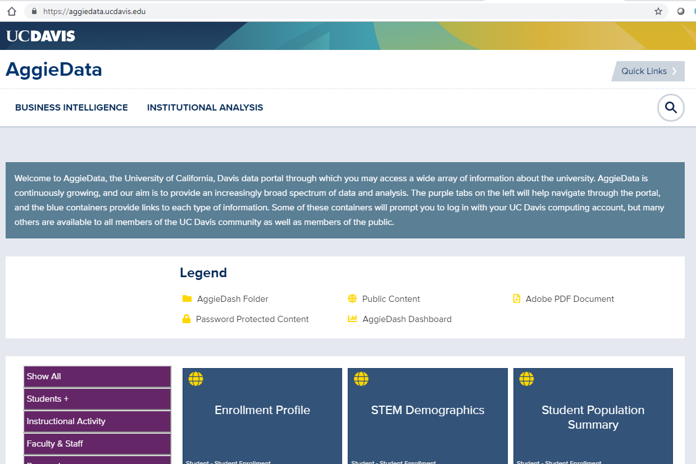
AggieData is Live! Check it out!
New Content! The Budget Context Report
Financial Aid

Slide 13
Today’s Presentations
Nick Barbulesco – Business Intelligence
Quick updates from the Business Intelligence Office
Max Monastyrskyy
Mutually Exclusive Filter Handling in Tableau
Brendan Livingston
Using parameters to explore your data in Tableau
Sarah Mangum, Adrina Gabriel, Tiffany Wright
Budget and Institutional Analysis’ Budget Context - the journey from paper planning documentation and reports to Tableau dashboards in AggieData
Joyce Cleaver
Financial Aid’s journey to Tableau Dashboards for official reporting

Slide 14
Thank you! Stay in touch!
businessintelligence@ucdavis.edu
Stop by the 375 Mrak Hall
Slack Channel: #dataanddonuts

Slide 15
A Sample of BI Partner Projects…
College of Engineering*
Campus Budget Office*
Enrollment Management and Financial Aid*
Information and Educational Technology
Mondavi Center
Safety Services*
Office of Research*
Institutional Analysis*
Supply Chain Management (AggieBuy / AggieTravel)
*dashboards in AggieDash

